Slide 1
“Art O’ Craft”
Group no: 76
Presented By :
Jyoti Dorage 233157
Sumaiyya Jamadar 233219
Project Guide: Mrs.Rupali Thorat Mam

Slide 2
Introduction
Objectives
Technology Used
Future scope
UML Diagrams
Screenshots
S/W and H/W
Requirement
Conclusion

Slide 3
INTRODUCTION
Art O’ Craft is a website that provides the function and features to authenticate and identify the users and provide them with easy, user-customizable web-interface for facilitating access to information and services that are of primary relevance and interests to them.
Customers can buy different artforms from site instead of going out to a art gallery.
The Purpose of project is to make a full functional art and gallery system that allows its customers to search and buy different artforms online .

Slide 4
OBJECTIVES
To produce a web-based system that allow the admin to give access to artists to add their various arts and also able to update, delete their artforms.
To ease customer by providing different functionalities to it.
Customers can buy artforms online.

Slide 5
Technology Used
Backend-SpringBoot
Frontend-ReactJS
Darabase-Mysql

Slide 6
Future scope
The world of art has undergone a significant shift in recent years, with the rise of online art galleries. These digital platforms have made it possible for artists to reach a wider audience and for art collectors to purchase artworks from anywhere in the world
.One of the most significant developments in the future of online art galleries is the integration of virtual reality and augmented reality . These technologies will allow art collectors to view and experience artworks in a much more immersive way
The future of online art galleries also includes the growth of the use of artificial intelligence (AI) and machine learning (ML). These technologies can be used to create personalized art recommendations for art collectors, based on their preferences and viewing history.
The future of online art galleries also includes the growth of the use of 3D printing technology. This technology can be used to create physical versions of digital artworks, which can be purchased and collected by art collectors

Slide 7
UML DIAGRAMS

Slide 8
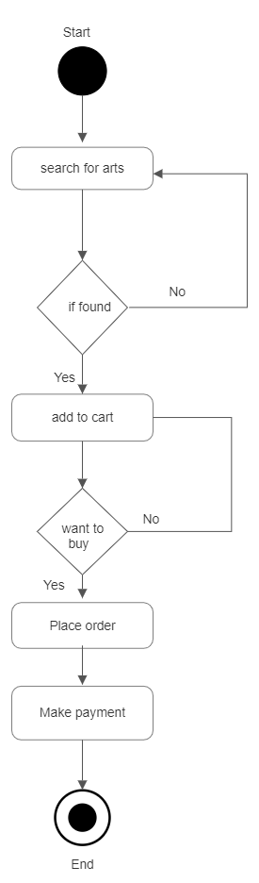
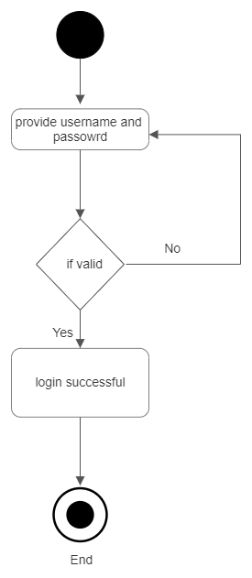
Activity Diagram :

Slide 9
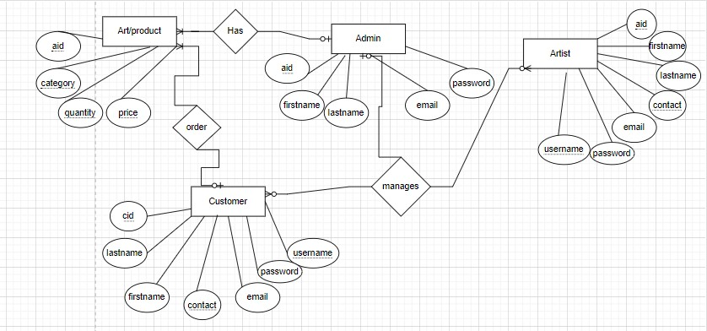
ER Diagram :

Slide 10
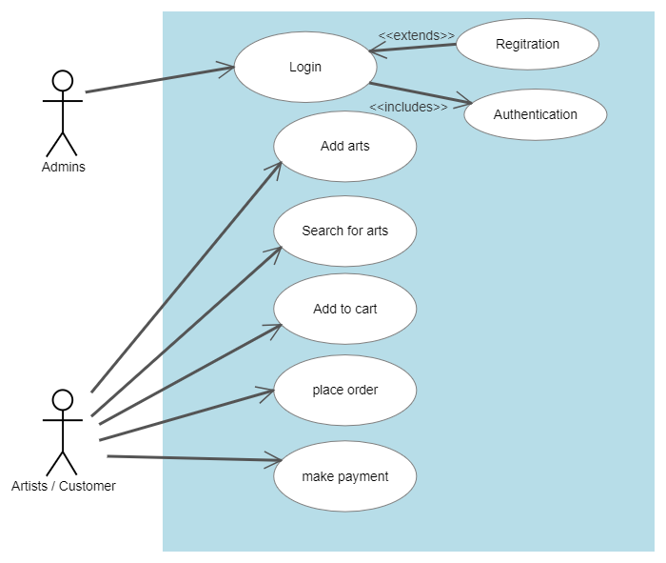
Use case diagram :

Slide 11
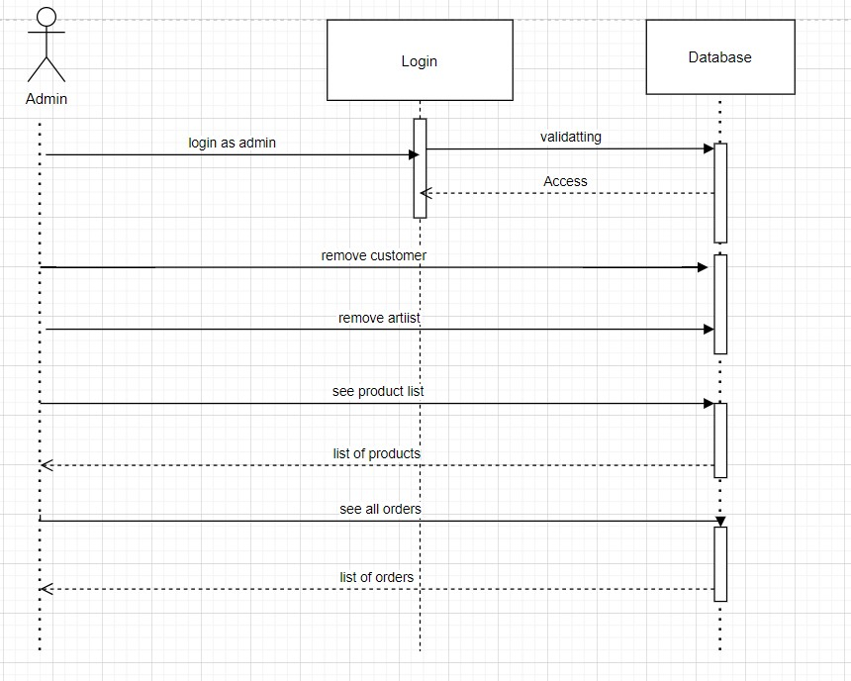
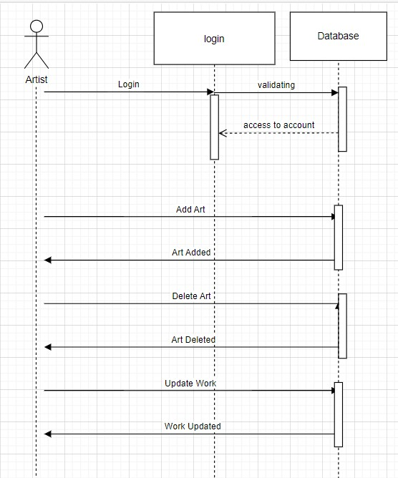
Sequence diagram :

Slide 12
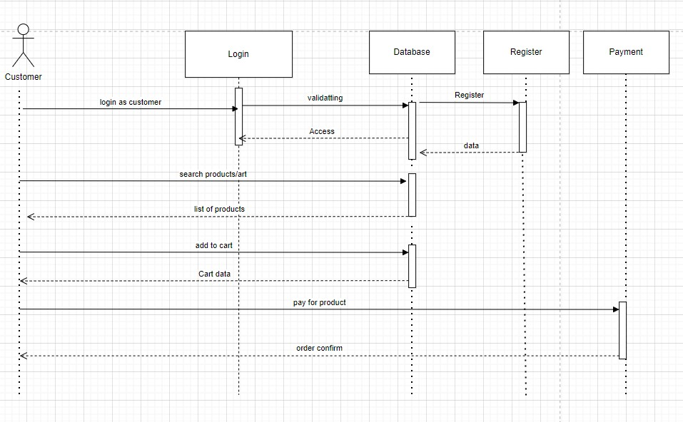

Slide 13
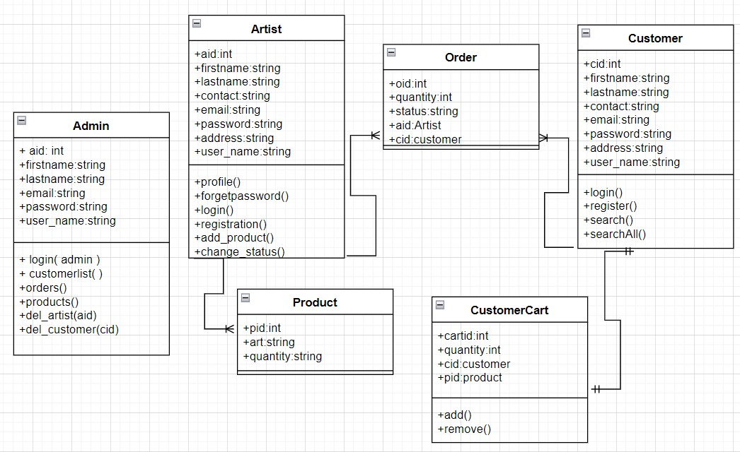
Class diagram :

Slide 14
SCREENSHOTS

Slide 15
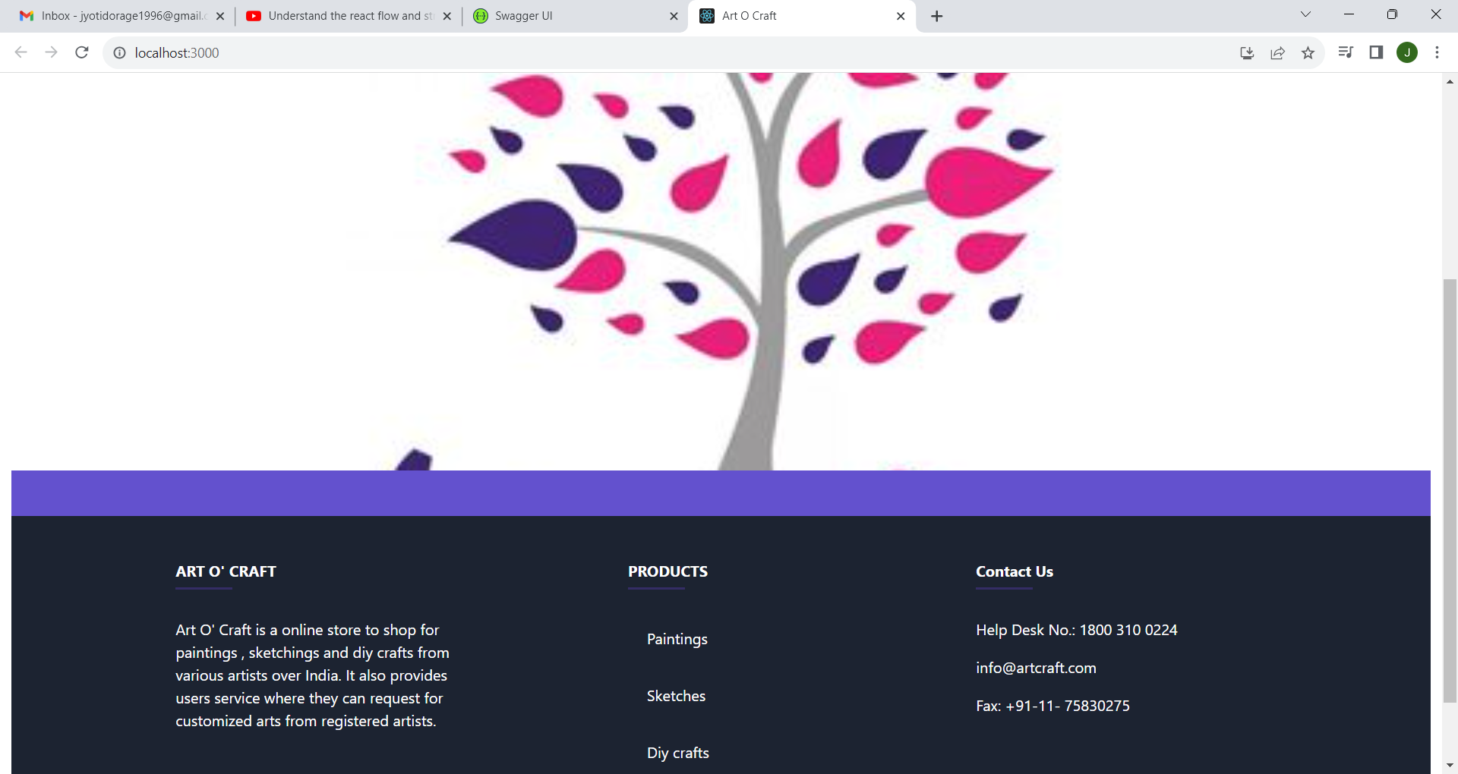

Slide 16
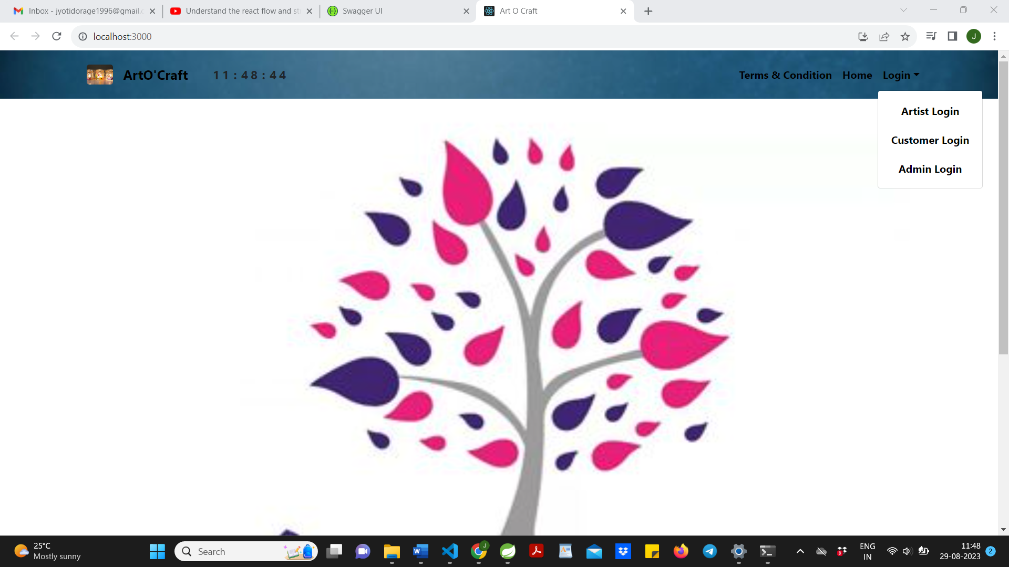

Slide 17
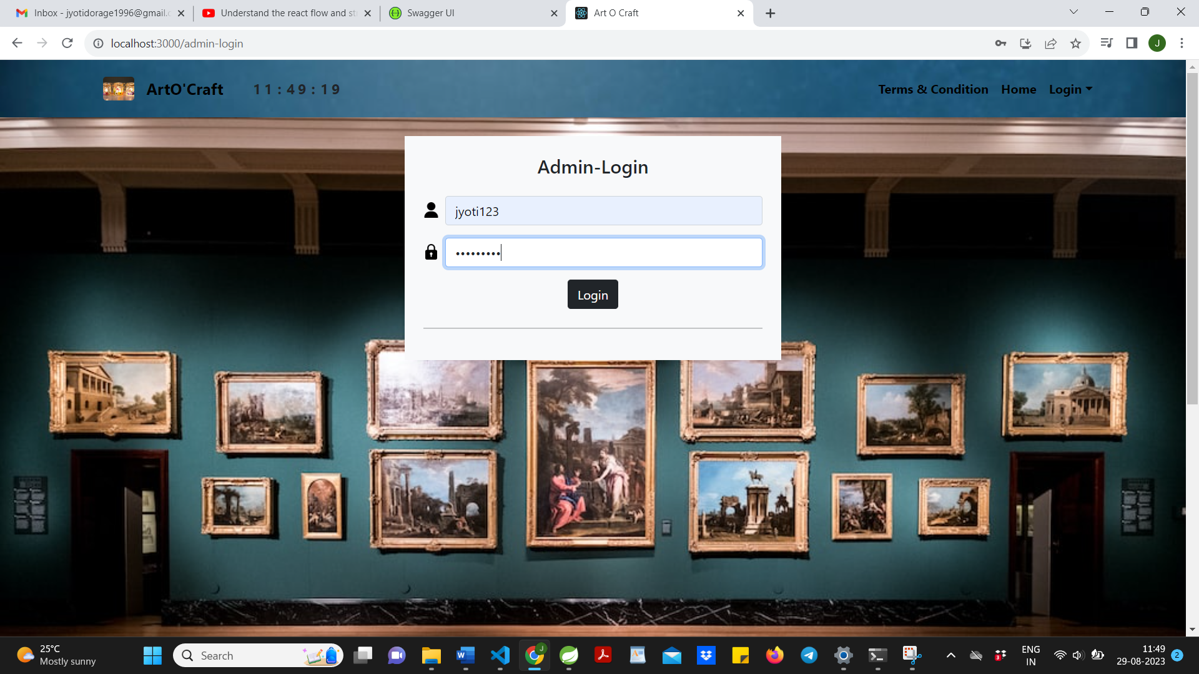

Slide 18
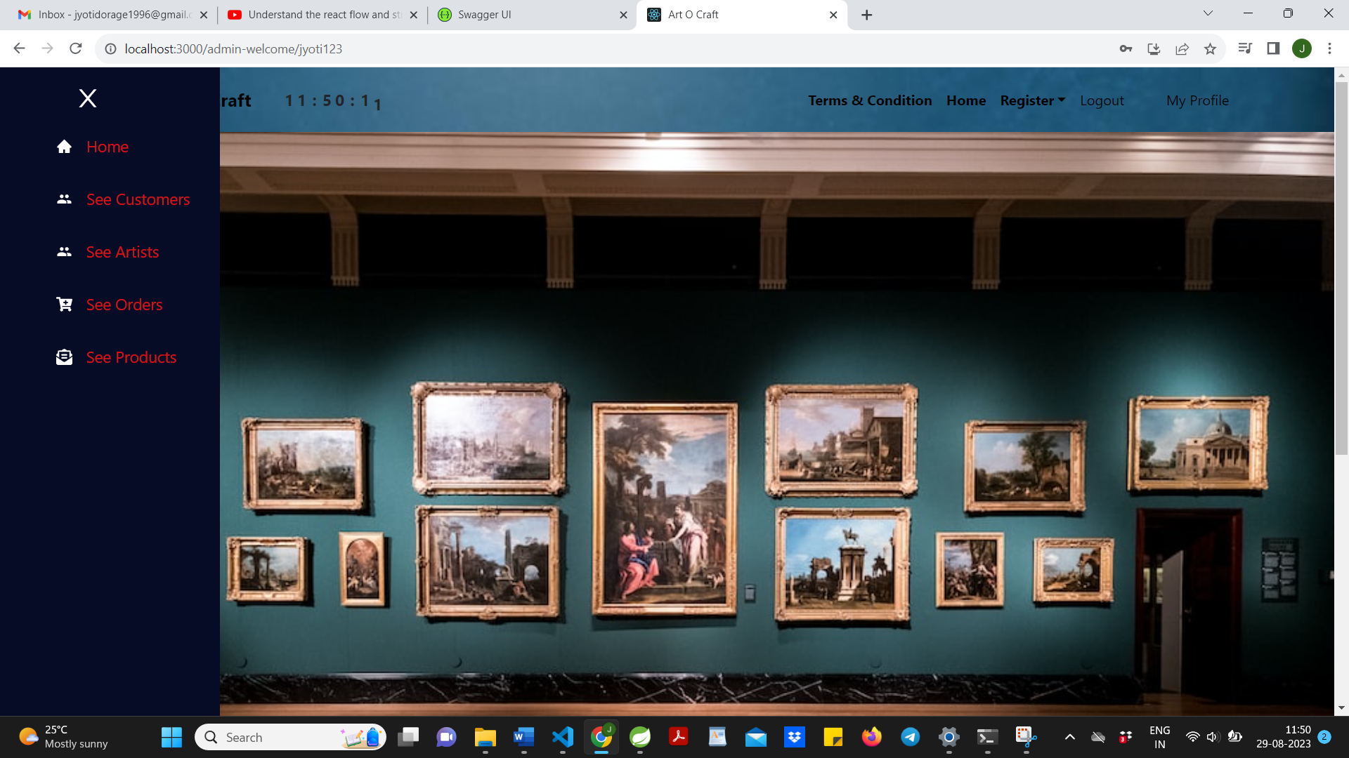

Slide 19
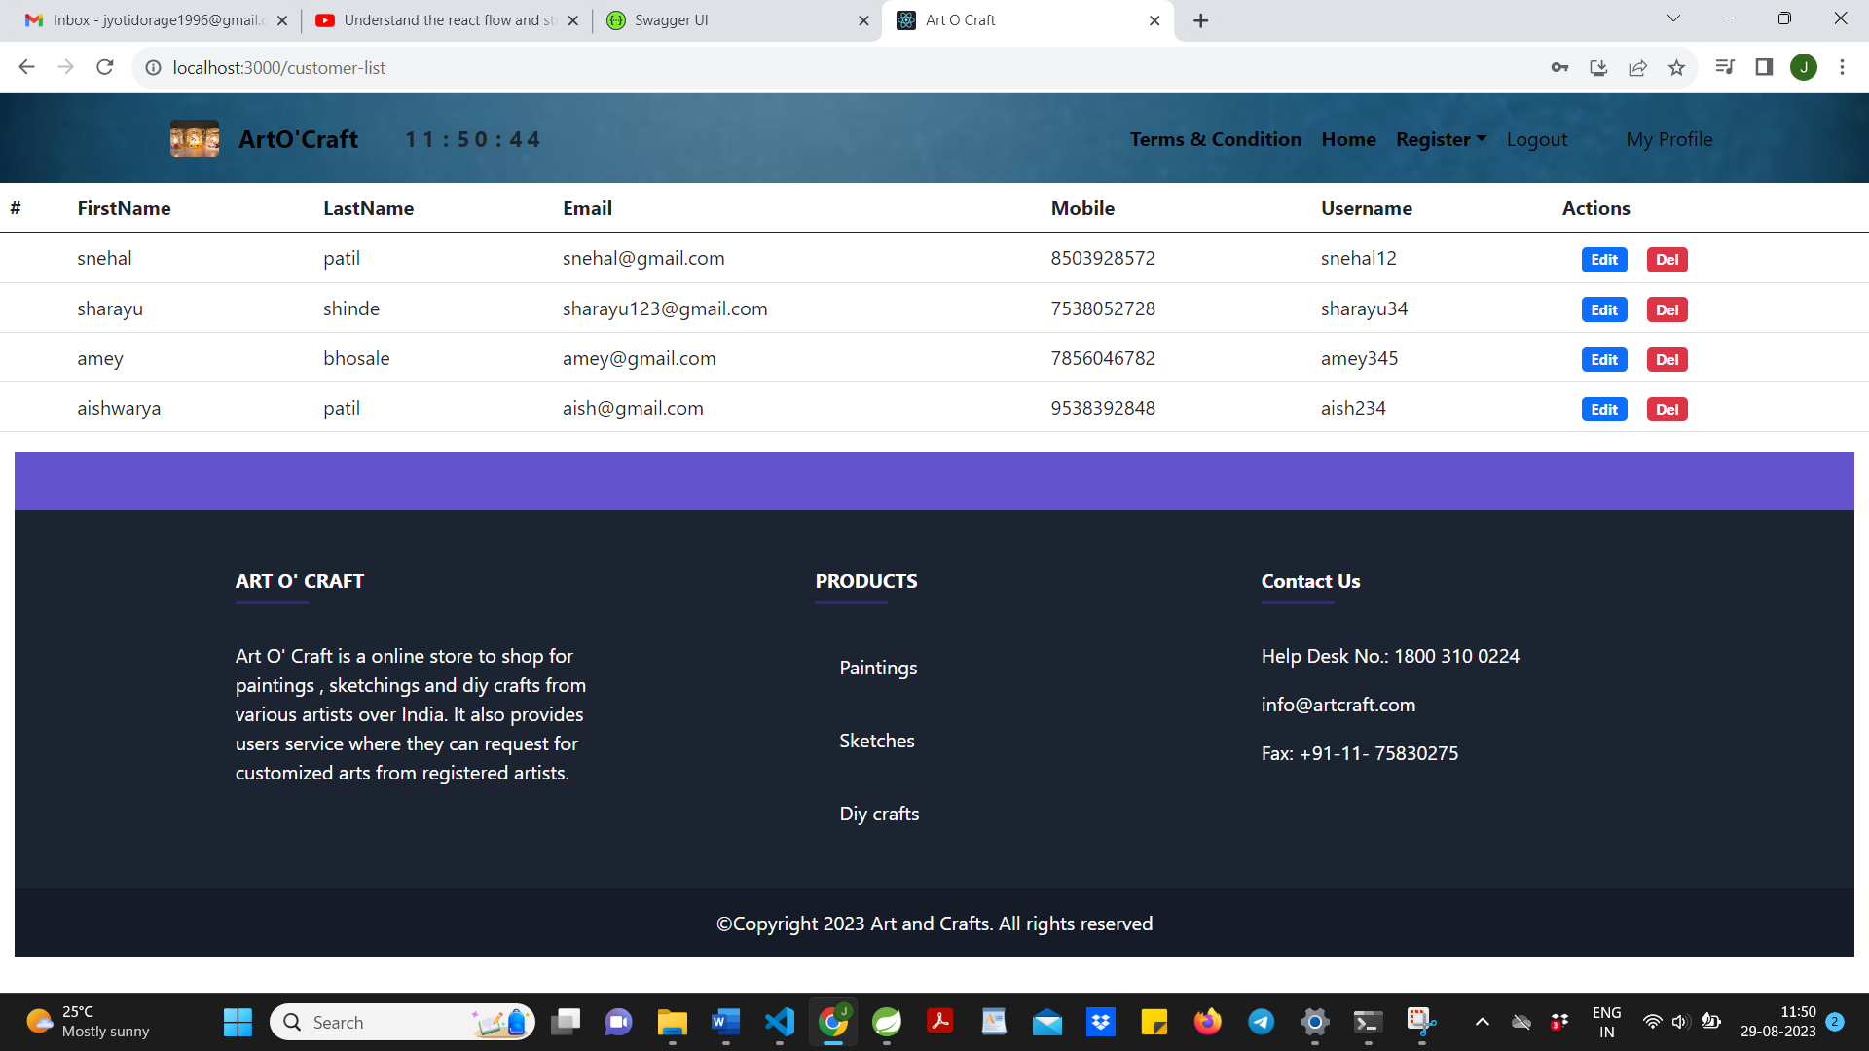

Slide 20
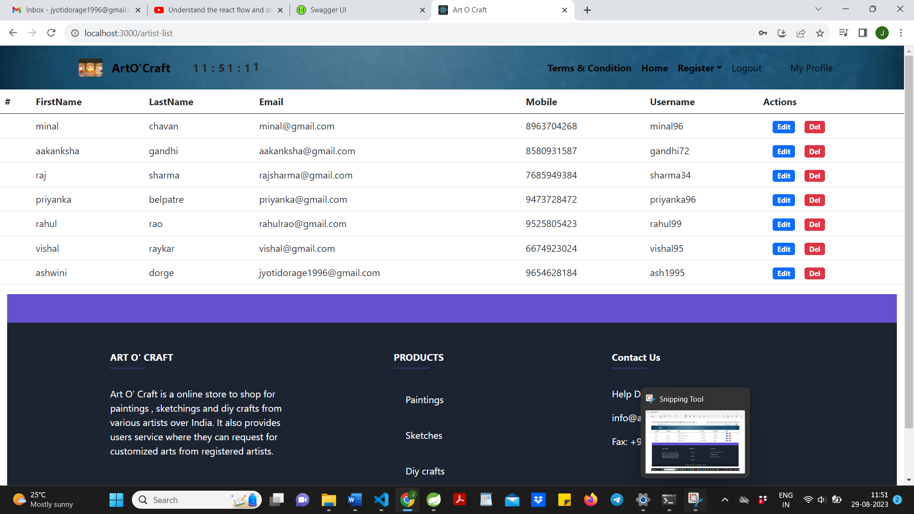

Slide 21
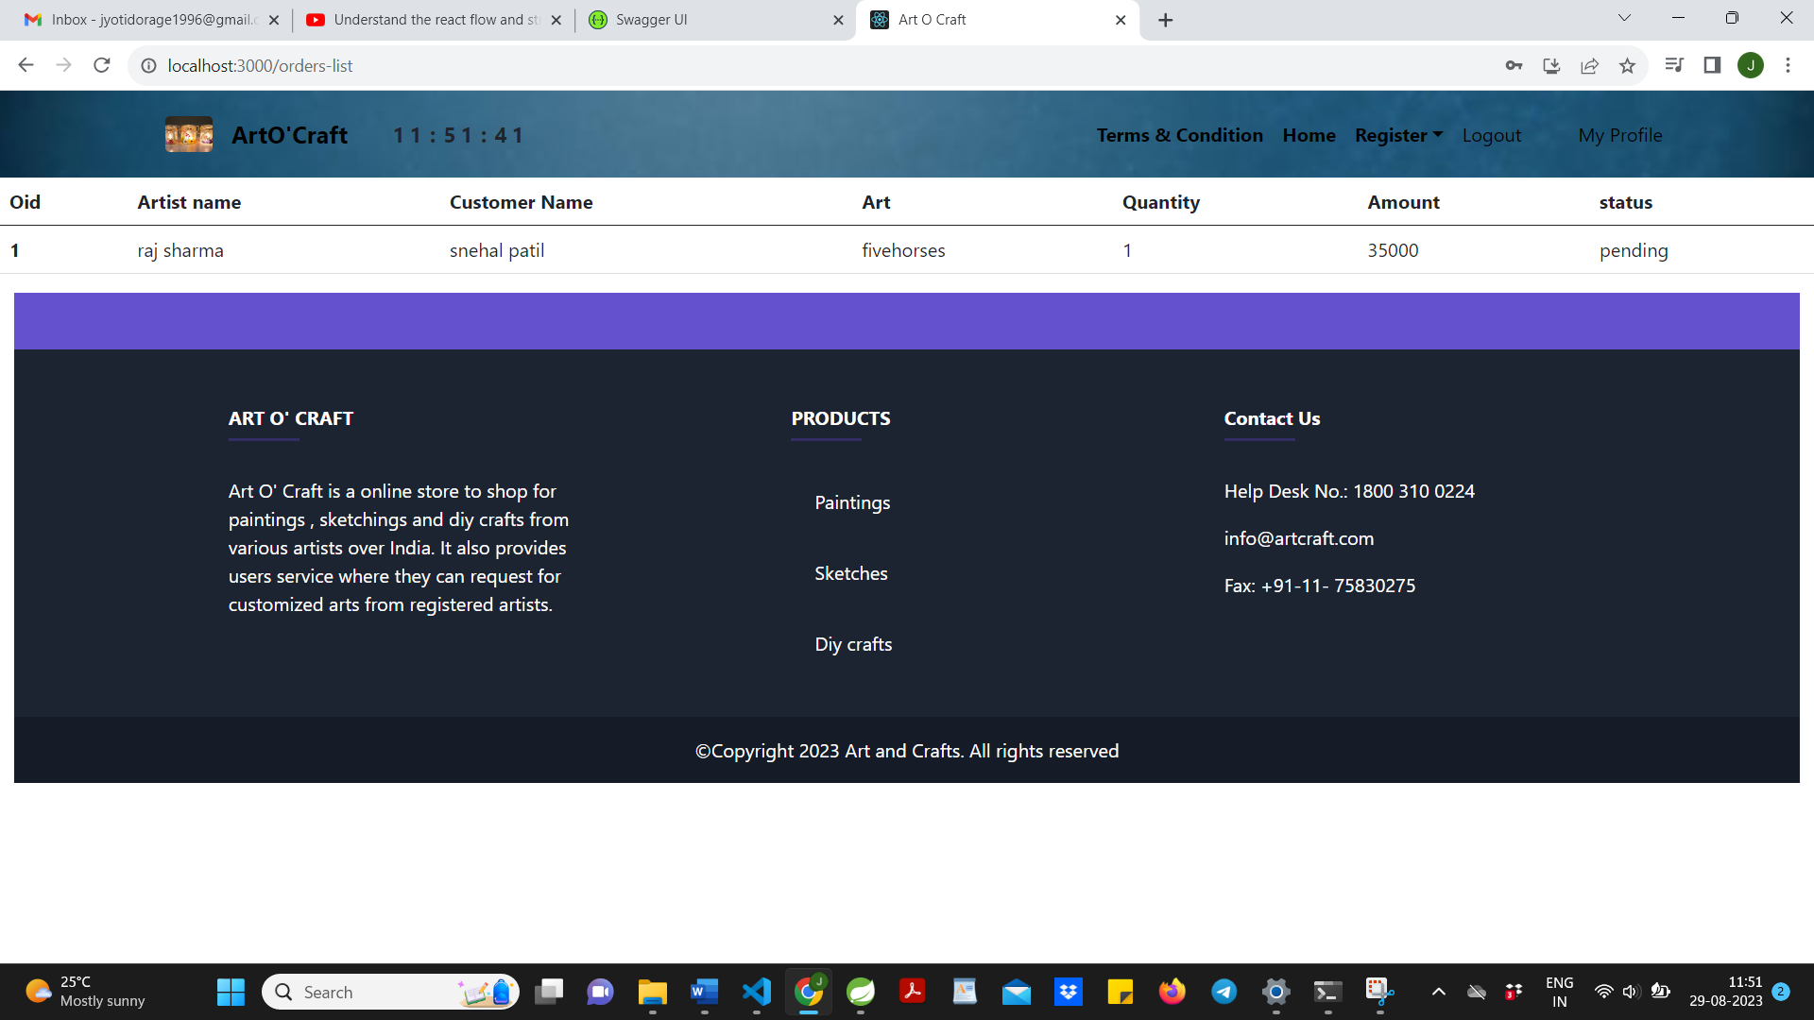

Slide 22
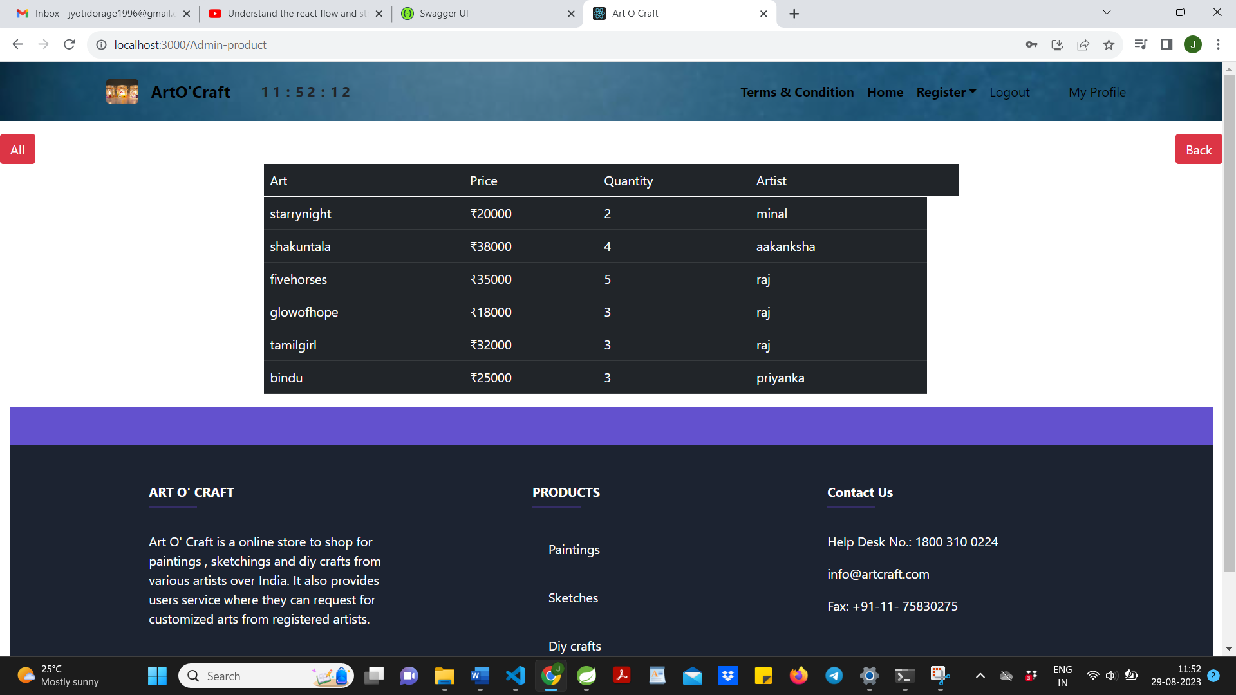

Slide 23
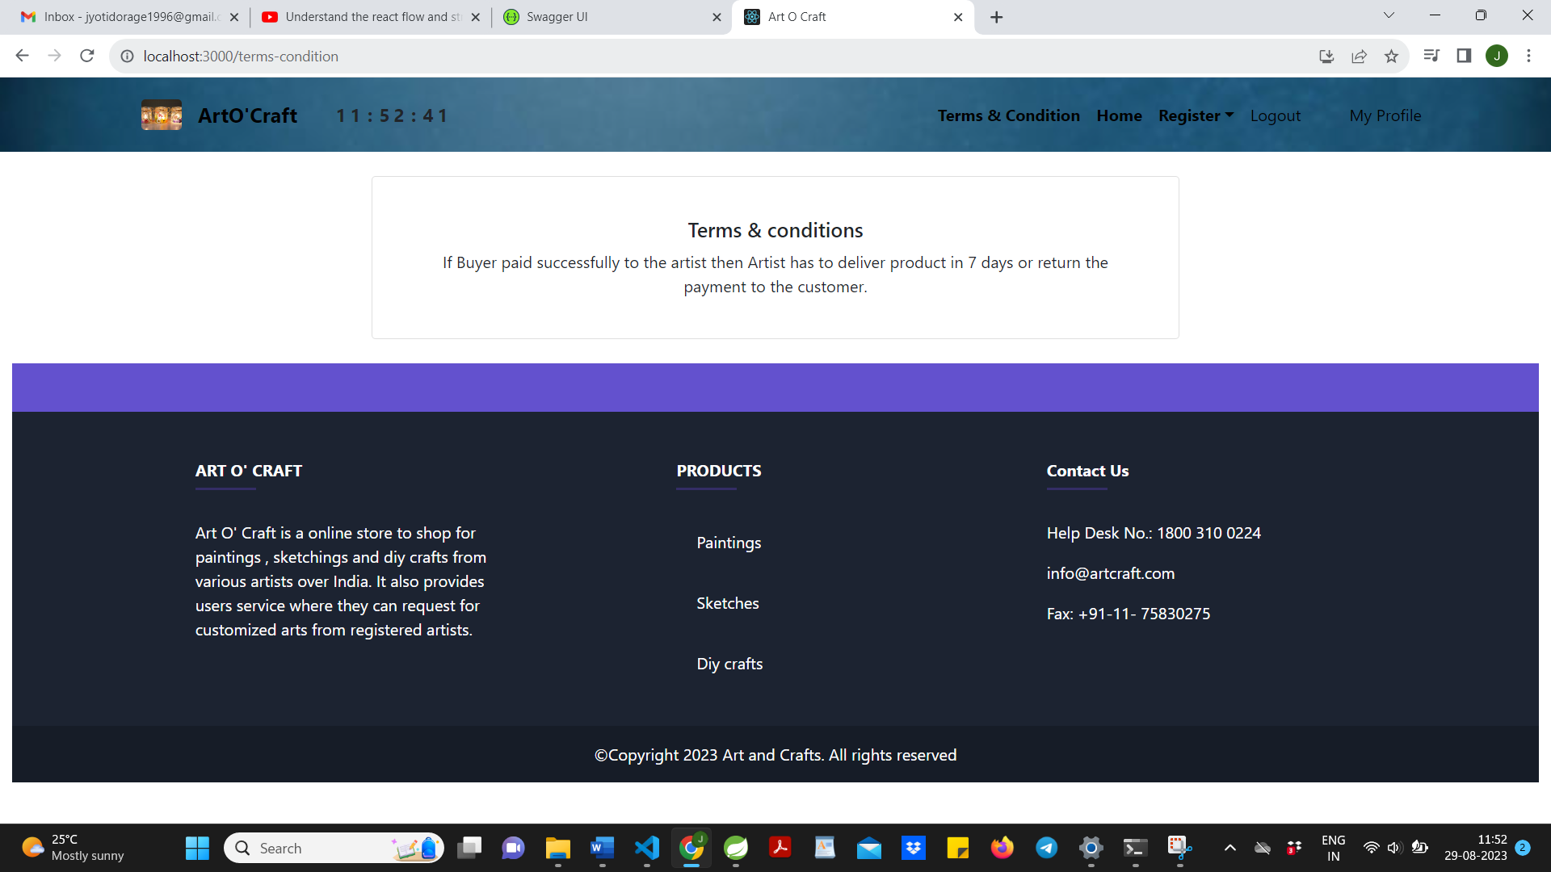

Slide 24
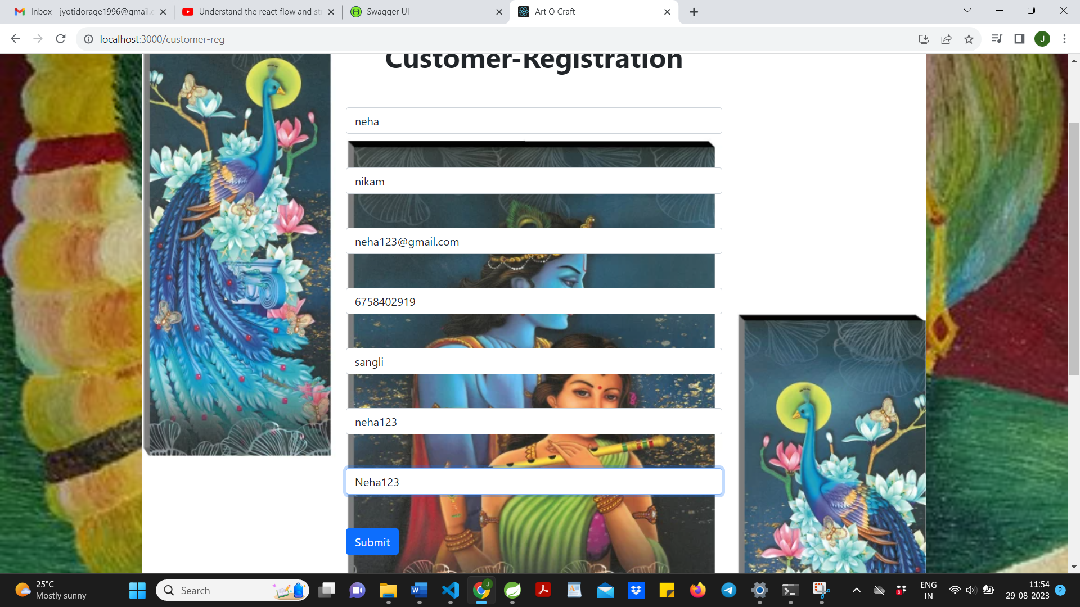

Slide 25
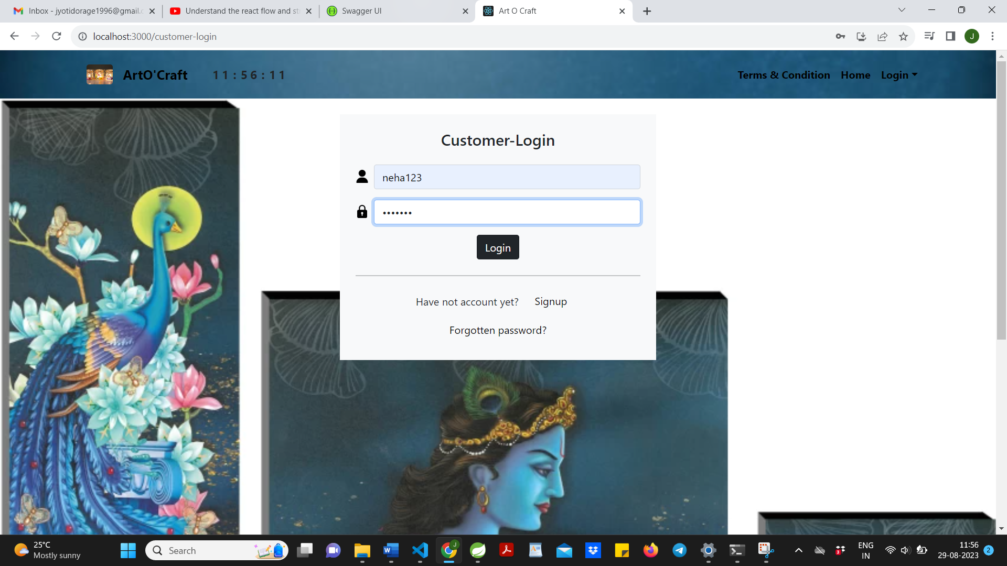

Slide 26
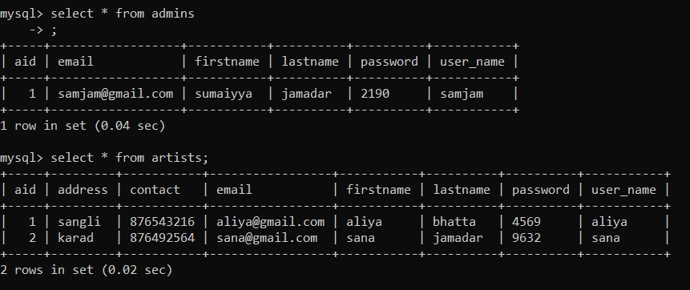
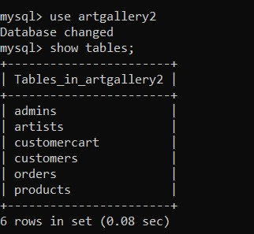
Database Designs

Slide 27
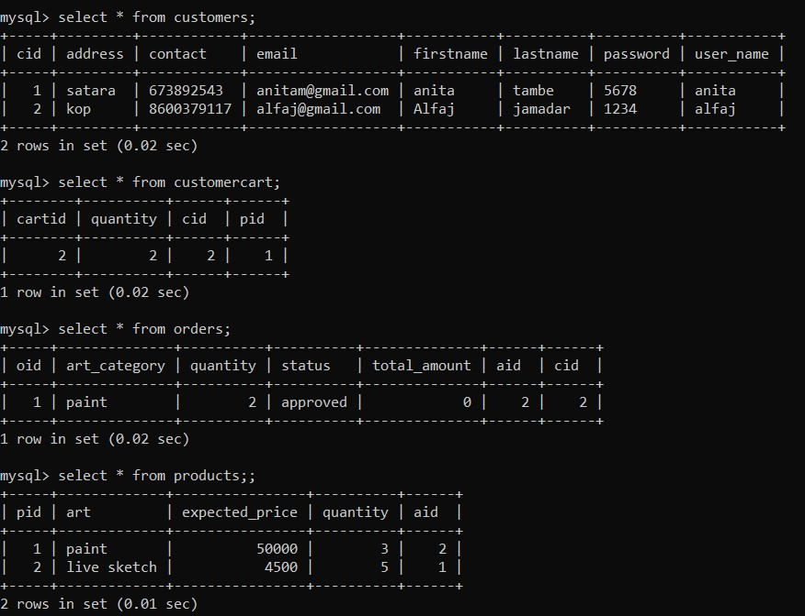

Slide 28
S/W and H/W requirement
Hardware requirements :
Processor : i5 or higher
Memory : 4 GB or higher
Software requirements :
Language : HTML , CSS , JavaScript
Database : MySql
Backend : Spring boot

Slide 29
Future Scope
The world of art has undergone a significant shift in recent years, with the rise of online art galleries. These digital platforms have made it possible for artists to reach a wider audience and for art collectors to purchase artworks from anywhere in the world.
.One of the most significant developments in the future of online art galleries is the integration of virtual reality and augmented reality . These technologies will allow art collectors to view and experience artworks in a much more immersive way.
The future of online art galleries also includes the growth of the use of artificial intelligence (AI) and machine learning (ML). These technologies can be used to create personalized art recommendations for art collectors, based on their preferences and viewing history.
The future of online art galleries also includes the growth of the use of 3D printing technology. This technology can be used to create physical versions of digital artworks, which can be purchased and collected by art collectors

Slide 30
Conclusion
This project aid in automating the existing manual system. This is a paperless work. It can be monitored and guarded remotely also provide accurate information .
Online art gallery Store the customer can purchase various artforms online. It is different from the traditional physical stores as it helps to overcome problem of limited space and narrow sales channels and other issues, for people to purchase arts.
Online art gallery store system can easily find the information and purchase artforms. Also the operating conditions are simple, user-friendly, to a large extent to solve real-life problems in the purchase of arts.

Slide 31
Reference
React Tutorial (w3schools.com)
Spring Data JPA - Reference Documentation
React – A JavaScript library for building user interfaces (reactjs.org)
Bootstrap · the most popular HTML, CSS, and JS library in the world. (getbootstrap.com)
Geeksforgeeks

